Slide 1

2024
Università degli Studi di Messina
A Deep Dive into CAN Communication and Multithreading Simulation
Name: Aditi Ghosh
Matricola:551413
Submitted to:
Prof. GIOVANNI MERLINO

Slide 2

1
Introduction
CONTENTS
2
Communication & Visualization
3
Analysis of Implementation
4
Real-Time Simulation and Output
5
Conclusion

Slide 3
01
Introduction
PART

Slide 4
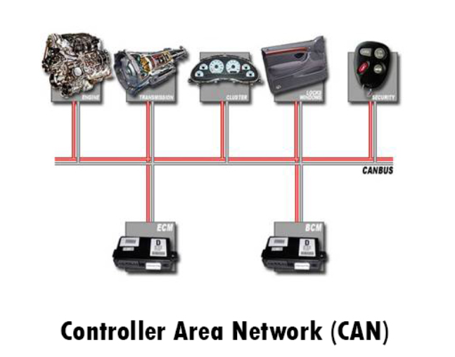
Controller Area Network (CAN)
Controller Area Network (CAN), a communication protocol pivotal in revolutionizing industries.CAN, widely employed in automotive and industrial applications, offers real-time communication among electronic control units, optimizing data exchange efficiently.
Simulation allows us to ensuring that CAN devices seamlessly communicate and prioritize messages, as we explore the capabilities of virtual CAN interfaces and simulation scripts, we'll see how CAN's robust design plays a pivotal role in ensuring reliability and efficiency in data transmission.
Notes:
Image Reference:https://www.itrelease.com/2021/10/what-is-controller-area-network-can-with-example/

Slide 5
Overview of Communication and Multithreading Simulation
The focus is on message prioritization, where the unique identifier in CAN messages determines both content and priority.
It introduces interfaces and explains how these virtual interfaces are utilized in the context of the provided code, specifically in the simulation of CAN messages and further explores the central_control.py script, which serves as a control unit for a node on a simulated CAN bus. The script continuously listens for incoming CAN messages and handles them based on their message ID.
A real-time visualization script is introduced, utilizing the 'matplotlib' library to create dynamic plots representing CAN messages received on virtual CAN interfaces.
The discussion then shifts to the simulation of a CAN system addresses the concept of a race condition in multithreading. The use of a lock to address the potential race condition is explained, emphasizing the importance of proper synchronization in a multi-threaded environment with three nodes.The provided code uses Python's threading and queue mechanisms to simulate message handling by different nodes, message prioritization, and visualization of CAN message priorities over time.

Slide 6
Virtual CAN Interfaces (vcan0 and vcan1)
vcan0 and vcan1 are software-based interfaces simulating a CAN bus on a computer. Essential tools for creating a virtual environment for CAN communication.'vcan' Module,kernel module is a piece of code that can be loaded and unloaded into the kernel.Provides necessary functionalities for virtual interfaces.
Facilitate Testing: Allow developers to simulate CAN communication without physical components.
Debugging: Aid in identifying issues, testing scenarios, and debugging software before deploying on real hardware.
Versatility: Provide a flexible environment for testing various CAN scenarios without the need for physical connections.
sudo modprobe vcan
Enables the virtual CAN interfaces (vcan0 and vcan1) for use.
Necessary step for the virtual interfaces to function properly.

Slide 7
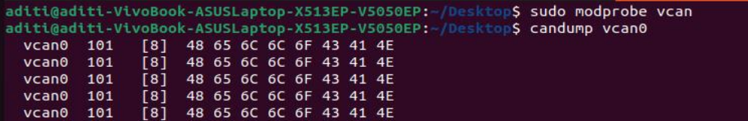
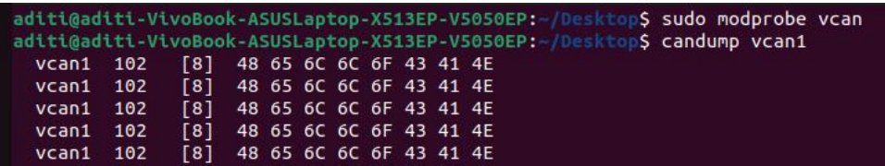
CAN Simulation with 'can_simulator.py'
Here, 'can_simulator.py' serves as a crucial component in simulating CAN messages on virtual CAN channels.Focusing on Multiprocessing and Concurrent Simulation:
The script leverages the 'multiprocessing' module, allowing for concurrent execution of processes.
Two distinct processes ('p1' and 'p2') simulate CAN traffic on 'vcan0' and 'vcan1' simultaneously.
CAN utilized for creating CAN messages and handaling the Communication on virtual channels.
It creates a CAN bus object and sends custom CAN messages with specified arbitaration ID and DATA.

Slide 8
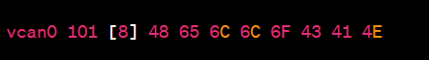
CAN Message Monitoring with candump
Candump is a powerful tool used for monitoring and capturing CAN bus messages in real-time.
Features:
Monitors and logs messages sent on the CAN bus.
Offers a detailed view of the CAN frame including the CAN ID and data payload.
Use Cases:
Debugging and troubleshooting in CAN communication systems.
Analyzing network traffic for performance optimization.
Interpretation:
vcan0: Virtual CAN interface used for monitoring.
101: CAN ID in hexadecimal.
[8]: Indicates the CAN frame has a payload of 8 bytes.
48 65 6C 6C 6F 43 41 4E: Hexadecimal values representing the ASCII string "HelloCAN".

Slide 9
02
Communication & Visualization
PART

Slide 10
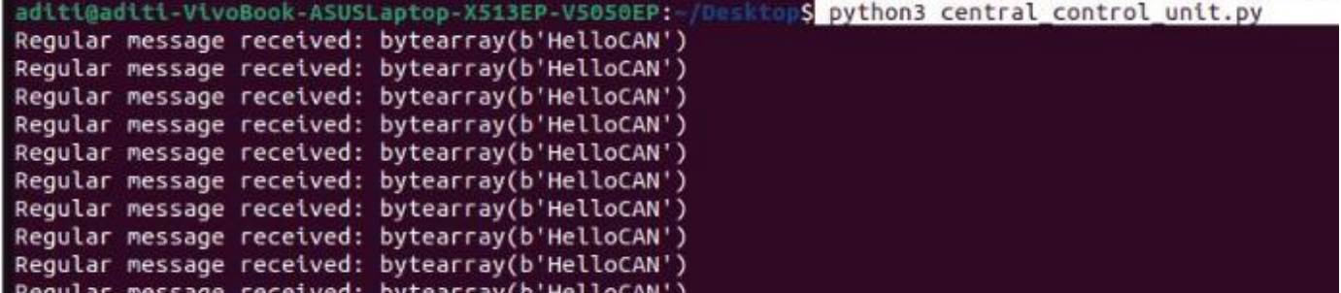
Listening to Messages on vcan0:
The script actively listens to messages on the virtual CAN interface vcan0.
This interface is a key communication channel within our simulated environment.
Handling Messages Based on Their ID in a Simulated Control Logic:
Messages received on vcan0 are processed using a predefined control logic within the script.The control logic involves inspecting the identifier (ID) of each message to determine the appropriate action. .
Central Control Script ('central_control.py')

Slide 11
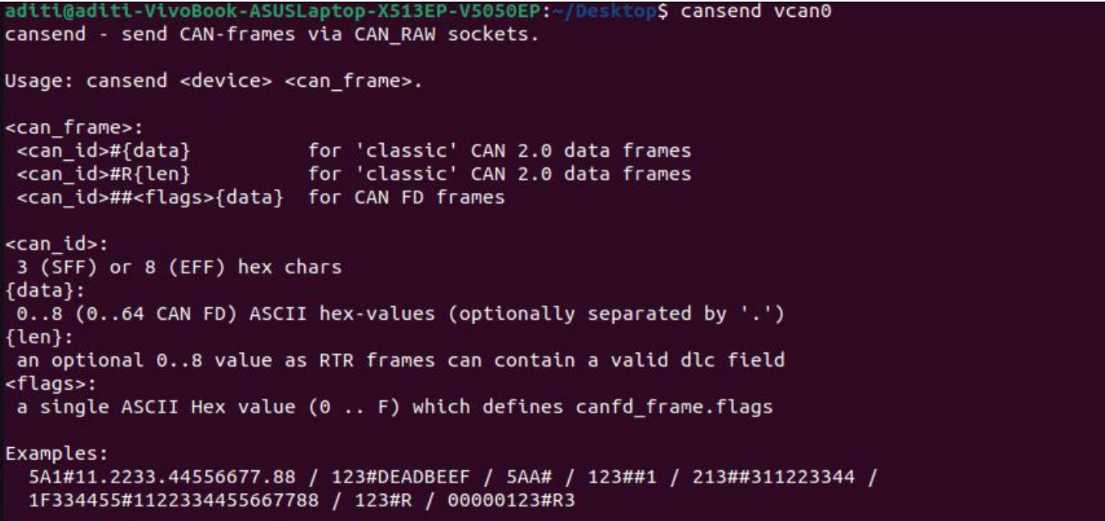
Central Control Script
As its start listening on the specified virtual CAN interface (‘vcan0’).
cansend vcan0 123#11223344AABBCCDD
‘vcan0’is the virtual CAN interface,‘123’is the CAN ID in hexadecimal, ‘11223344AABBCCDD’is the data payload.
I need to replace ‘123#11223344AABBCCDD’ with the specific CAN frame I want to send, including the CAN ID and the data payload.

Slide 12
Real-Time Visualization with 'receive_and_plot'
The 'receive_and_plot' script is designed for real-time visualization of CAN messages received on virtual CAN interfaces ('vcan0' and 'vcan1').
Functionality:The script dynamically creates plots using the popular Matplotlib library to visualize the data bytes of CAN messages.
Key Features:Real-time updating of plots as messages are received.Separate plots for 'vcan0' and 'vcan1' for better distinction.
Dynamic Plot Creation using Matplotlib:Matplotlib is employed for creating interactive and dynamic plots within the script.Two subplots ('ax1' for 'vcan0' and 'ax2' for 'vcan1') are created to represent the data bytes of CAN messages.
Visualization Updates: - Two threads (‘thread_vcan0’ and ‘thread_vcan1’) run the visualization functions concurrently for each virtual CAN channel.
Lists of lines (‘lines_vcan0’ and ‘lines_vcan1’) are created for each data byte to be plotted with different colors.

Slide 13
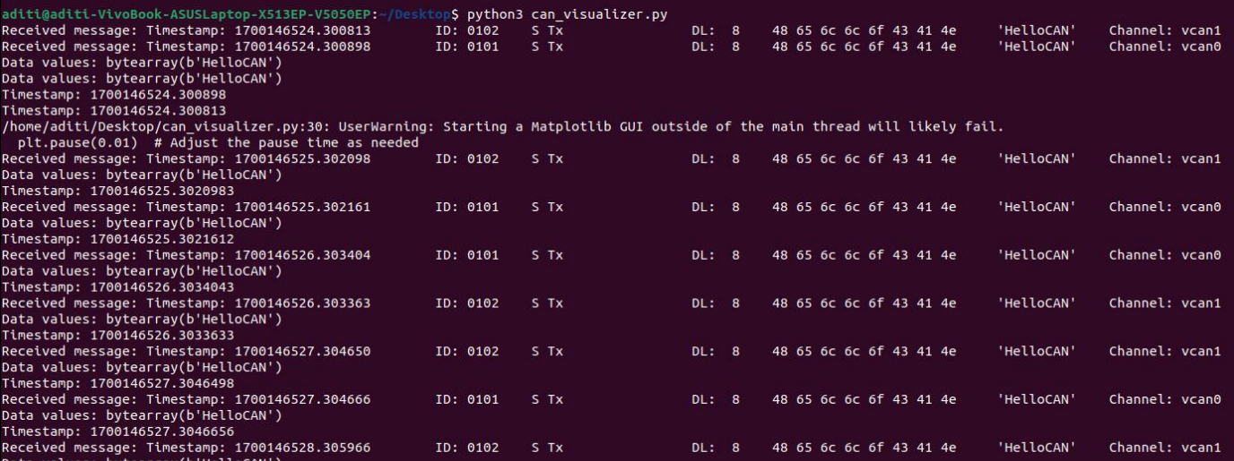
Real-Time Visualization with 'receive_and_plot'
It appears that the script is receiving messages correctly, and the received data (in this case, the message 'HelloCAN') is consistent between the two virtual CAN channels (‘vcan0’ and‘vcan1’). The timestamp is also being printed, and it represents the time at which each message is received.

Slide 14
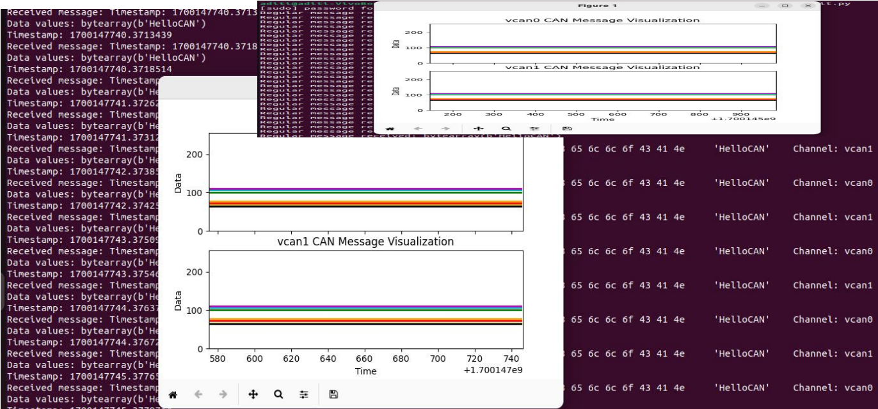
Visual Result:
As CAN messages are received, the plot updates in real-time, we can see the lines moving orchanging their values on the plot in response to CAN bus activity.The axes are adjusted dynamically to fit the changing data, ensuring a clear and informative visualization.

Slide 15
03
Analysis of Implementation
PART

Slide 16
Race Condition and Synchronization
A race condition occurs when multiple threads access shared data simultaneously, leading to unpredictable and undesired outcomes. Threads may interfere with each other's access to shared resources, causing data inconsistency and unexpected behavior. I have Introduced the shared_variable as an example of shared data which is a counter accessed and modified by multiple threads simultaneously.
Here, Sincronization is also matters because it prevents race conditions, maintains data consistency, and ensures predictable program behavior.Introducing a lock to synchronize access to the shared_variable.
Benefits of Synchronization
Data Integrity: Ensures that shared data remains consistent and accurate.
Predictable Behavior: Prevents unexpected results and guarantees the intended execution sequence.
Application Reliability: Enhances the reliability of multithreaded applications.Ensuring that locks are applied consistently and released appropriately. Identifying areas of code where synchronization is crucial. Balancing synchronization with the need for efficient parallel execution.

Slide 17
Simulation of Nodes in System
The simulation script is designed to emulate a multi-node CAN (Controller Area Network) system. It provides a virtual environment where nodes interact by sending and receiving CAN messages.
Simulated Nodes:
Node 1 (Engine Heat Monitor):Responsible for sending temperature information every second.
Simulates a regular node with periodic data transmission.
Node 2 (Obstacle Finder):Checks its surroundings every half second.Sends an "emergency" warning message if an issue is detected.
Main Control (Node 3):Central unit receiving messages from both Node 1 and Node 2.Demonstrates handling "emergency" warnings with higher priority.Handling of Emergency Messages:
The script illustrates how nodes handle emergency messages promptly.Emergency messages have a higher priority, ensuring rapid response and action.

Slide 18
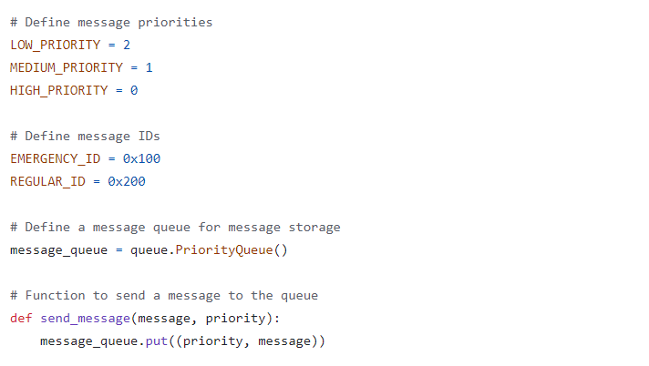
Message Priorities and IDs
Message Priorities:Prioritization determines the urgency and importance of a message. Priority levels facilitate efficient communication in real-time scenarios.
Message IDs:Differentiating between Emergency and Regular messages is crucial for handling priorities effectively.
Emergency Messages:Sent in critical situations that demand immediate attention.Typically assigned a higher priority for swift processing.
Example: Emergency warnings from safety-critical systems like an obstacle finder.
Regular Messages:Routine messages with standard information or updates.Assigned lower priorities compared to emergency messages.
Example: Periodic temperature updates from an engine heat monitor.

Slide 19
Message Queue and Sending Messages
Message Queue:A data structure that organizes messages based on their priorities.Ensures a systematic approach to handling messages in the order of their importance.
In the script, a PriorityQueue is created to store messages efficiently.Each message in the queue is associated with a priority, allowing for orderly processing.
Parameters:I have taken parameters like message content, priority, and ID. Dynamically adds messages to the PriorityQueue.
Simulate_message_generation Function: Simulates the generation of messages for testing purposes. Generates messages with different priorities, ensuring a diverse message set.
Implementation: Messages are simulated using the simulate_message_generation function.Priority levels and content are defined based on the requirements of the CAN simulation.
Importance:The send_message function and message simulation are crucial for creating a realistic test environment.Allows the script to mimic real-world scenarios with varied message types and priorities.

Slide 20
Message Handling Threads
Handling Threads:
Main Control Thread:- Responsible for central control and prioritizing emergency messages. Prioritizes handling emergency messages first. Uses the 'handle_emergency_message' function for rapid response.
Node 1 Thread - Simulates the behavior of an Engine Heat Monitor. Process regular messages based on their priorities. Each node may have specialized logic based on its function.
Node 2 Thread- Simulates the behavior of an Obstacle Finder.
message_handler Function:- Key Component of Each ThreadFunction responsible for processing incoming messages. Different logic for Main Control, Node 1, and Node 2.
Efficient Communication Flow:- Ensures each node can handle messages independently. Enhances the responsiveness of the simulated CAN system. Simplifies code maintenance and scalability.
Visual Representation:- Correlates with real-time visualization discussed earlier. Threads contribute I will show like the dynamic movement of lines in the plots.

Slide 21
Emergency Message Handling
Emergency messages play a crucial role in a CAN system.The 'handle_emergency_message' function is designed for rapid and prioritized response.
handle_emergency_message Function:-Main Control's Critical Responsibility,Swiftly handles messages identified as emergencies (ID: '0x100').Ensures immediate attention to critical events.
Responsibilities of Emergency Handling:Immediate halting of ongoing processes to address the emergency.Rapid decision-making based on the nature of the emergency message.
Implementation:
Shared Variable Update:Updates shared variable within a lock to avoid race conditions.
Statistics Recording: Records statistics for the emergency message, including count and timestamp.Examines the emergency message to determine the severity. Takes appropriate actions based on the nature of the emergency.

Slide 22
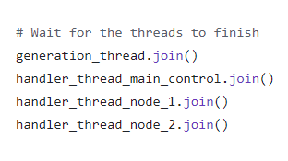
Waiting for Threads to Finish
`join()` Mitigates Race Conditions: `join()` prevents the main program from proceeding until all threads it's waiting on have finished.By using `generation_thread.join()` and `handler_thread.join()` calls, the main program ensures it waits for both message generation and handling threads to finish.
Benefits of `join()`:The usage of `join()` guarantees that statistics and messages are printed only after all threads have completed their tasks. This ensures a reliable and synchronized output, mitigating the race condition.

Slide 23
04
Simulation & Output
PART

Slide 24
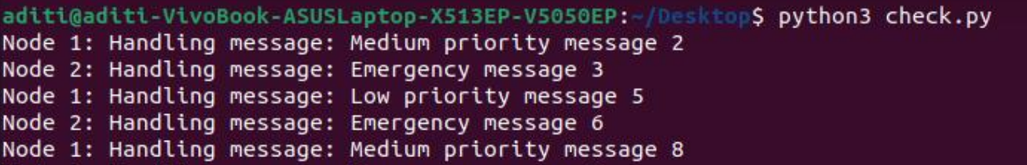
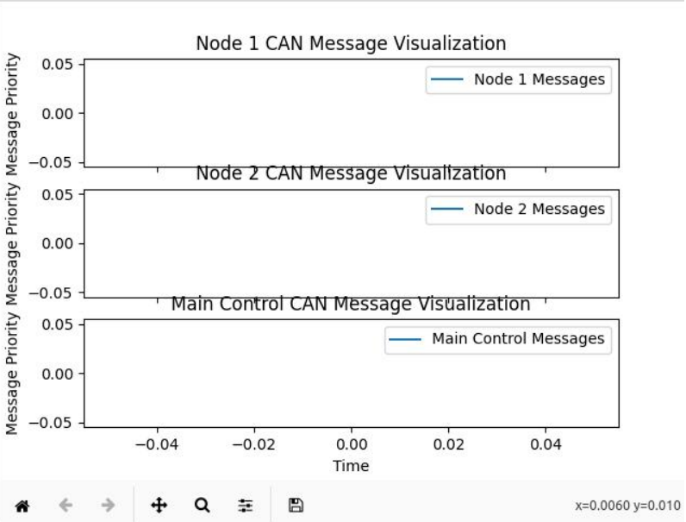
Output Results and Analysis
This output represents the flow of messages being handled by Node 1 and Node 2. It seems to align with the simulation I've set up, where different nodes handle messages of varying priorities.
On Node 2 and see the values x=0.0060; y=0.10, x=0.0060:This represents the timestamp or time elapsed since the start of the visualization. The y-value provides information about thepriority level of the message at that specific time. y=0.10:This represents the message priority at that specific timestamp. Therefore, a y-value of 0.10 would correspond to a message priority of 0
(HIGH_PRIORITY).
The focus is on how well the Main Control node handles emergency warnings.

Slide 25
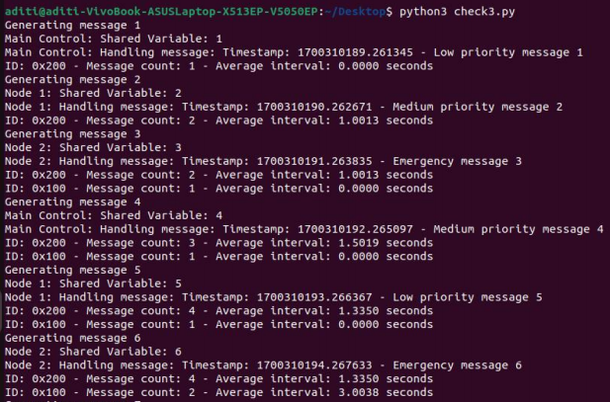
Output Results and Analysis
The output includes information about the shared variable, message handling timestamps, and message statistics. The shared variable serves of a potential race condition, and the lock is used to mitigate this issue.
Here,Generating message 2
- "Node 1" handles a medium-priority message with a shared variable value of 2. - Message statistics for ID 0x200 are updated, indicating a count of 2 and an average interval of 1.0013 seconds.

Slide 26
Output Results and Analysis
Analysis:
- The shared variable is being incremented by different threads.
- Message handling by nodes is demonstrated, and message statistics are continuously updated.
- The message statistics include message count and average interval for each message ID.
The output effectively demonstrates the concurrent execution of threads, potential race conditions
(shared variable updates), and the handling of messages by different nodes in a simulated CAN
system.

Slide 27
05
Conclusion
PART

Slide 28
Conclusion
In this deep dive into CAN communication and multithreading simulation, we have explored the pivotal role of Controller Area Network (CAN) in revolutionizing industries, particularly in automotive and industrial applications. The focus has been on understanding message prioritization, virtual CAN interfaces, and real-time visualization, along with addressing challenges like race conditions in a multithreaded environment.
The simulation output has demonstrated the concurrent execution of threads, message handling by different nodes, and the effective prioritization of emergency messages. The use of join() has been highlighted as a crucial mechanism to mitigate race conditions and ensure reliable and synchronized output.

Slide 29
Future Application:
By pursuing these future applications, the simulation environment can evolve into a versatile tool that not only serves as a testing ground for CAN communication but also contributes to the ongoing advancement of reliable and secure systems across diverse industries.
Advanced Message Handling Algorithms:- Develop and implement more sophisticated message handling algorithms that consider not only message priorities but also the dynamic network conditions. This could involve adaptive prioritization and routing strategies.
Fault Tolerance and Redundancy: - Test how the CAN system behaves in the presence of faults, and implement strategies for node recovery and data integrity.
Integration with AI and Machine Learning:- Explore the integration of artificial intelligence and machine learning algorithms to predict and adapt to changing communication patterns. This could lead to more intelligent and adaptive CAN systems.
Dynamic Network Topologies:- Enhance the simulation to support dynamic changes in network topologies. Simulate scenarios where nodes join or leave the network, and evaluate the system's ability to adapt to such changes.
Industry-Specific Applications: - Tailor the simulation for specific industries such as healthcare, aerospace, or industrial automation. Explore how CAN communication can be optimized and adapted to meet the unique requirements of these domains.
Continuous Research and Development: - Regularly update the simulation environment to incorporate the latest standards and address emerging challenges in the field.

Slide 30
THANKS

